Slide 1
Department of CSE, CSIT
COURSE NAME: Data science
COURSE CODE: 24AD3107
Topic:
Data Pipeline stages
Session - 6

Slide 2



AIM OF THE SESSION
To familiarize students with the basic concept of Data Pipeline stages
INSTRUCTIONAL OBJECTIVES
This Session is designed to: Introduction to Data Pipeline stages
LEARNING OUTCOMES
At the end of this session, you should be able to: basic knowledge of Data Pipeline stages

Slide 3
Key Concepts
SESSION INTRODUCTION
The 5 key components of a data pipeline
Why implement a data pipeline?
The five components of a data pipeline
The benefits of a data pipeline integration
How to implement a data pipeline

Slide 4
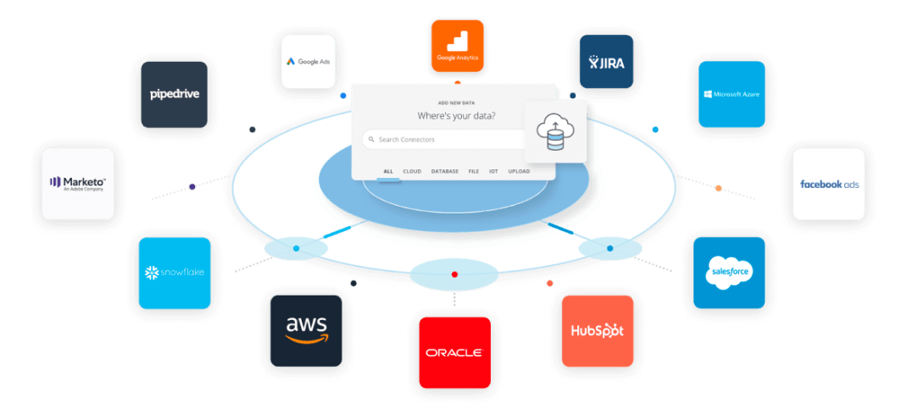
The 5 key components of a data pipeline
A data pipeline has five key components: storage, preprocessing, analysis, applications, and delivery. Understanding the five key components of a data pipeline helps organizations work with big data and use the insights they generate.

Slide 5
Why implement a data pipeline?
A data pipeline helps organizations make sense of their big data and transform it into high-quality information that can be used for analysis and business intelligence.
No matter how small or large, all companies must manage data to stay relevant in today’s competitive market.
Businesses use this information to identify customers’ needs, market products, and drive revenue.
Data pipeline integration is a huge part of the process because it provides five key components that allow companies to manage big data.

Slide 6
The five components of a data pipeline
Storage : The main function of storage is to provide cost-effective large-scale storage that scales as the organization’s data grows.
2. Preprocessing : This part of the process prepares big data for analysis and creates a controlled environment for downstream processes.
3. Analysis : provides useful insights into the collected information and makes it possible to compare new data with existing big data sets. It also helps organizations identify relationships between variables in large datasets to eventually create models that represent real-world processes.
4. Applications : The fourth component of a data pipeline is applications, which are specialized tools that provide the necessary functions to transform processed data into valuable information.
5. Delivery : The final component of a data pipeline is delivery, which is the final presentation piece used to deliver valuable information to those who need it.

Slide 7
The benefits of a data pipeline integration
A strong data pipeline integration allows companies to:
Reduce costs: By using a data pipeline that integrates all five components, businesses can cut costs by reducing the amount of storage needed.
Speed up processes: A data pipeline that integrates all five components can reduce delivery time to make valuable information much faster.
Work with big data: Because big data is difficult to manage, it’s important for companies to have a strategy in place to store, process, analyze, and deliver it easily.
Gain insights: The ability to analyze big data allows companies to gain insights that give them a competitive advantage in the marketplace.
Include big data in business decisions: Organizational data is critical to making effective decisions that drive companies from one level to the next.

Slide 8
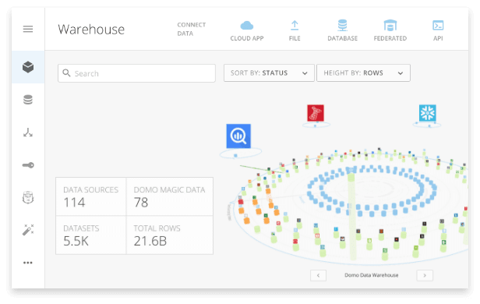
The benefits of a data pipeline integration
Notes:
1. Title: Warehouse
This is the Data Warehouse section, where all datasets from multiple sources are stored, integrated, and managed.
🔹 2. Data Sources
Shows 114 data sources → These are external connections like cloud apps, files, databases, APIs, etc.
Data is ingested into the warehouse for further use.
🔹 3. Domo Magic Data
78 Magic Data Flows → Refers to transformation pipelines built inside Domo.
These flows clean, join, and process raw data into usable datasets for analytics.
🔹 4. Datasets & Rows
5.5K datasets → Total number of tables available inside the warehouse.
21.6B rows → Size/volume of the data being stored and processed.
🔹 5. Visual Representation (Circular Layout)
The circle diagram represents datasets and data sources.
Each icon is a data source or dataset node, connected in a hub-and-spoke model.
Different colors/icons represent different types of sources (databases, cloud apps, etc.).
🔹 6. Connect Data Options (Top Menu)
Cloud App → Connect SaaS applications like Salesforce, Google Analytics, etc.
File → Upload CSV, Excel, JSON files.
Database → Connect traditional RDBMS like MySQL, SQL Server, Oracle.
Federated → Query external data without storing it.
API → Pull data from REST/other APIs directly.
🔹 7. Purpose
This dashboard gives:
✅ A summary of data assets (sources, datasets, rows).
✅ Centralized view of warehouse with connections between raw data and transformed datasets.
✅ Easy integration, transformation, and monitoring of all enterprise data.

Slide 9
1. Title: Warehouse
This is the Data Warehouse section, where all datasets from multiple sources are stored, integrated, and managed.
🔹 2. Data Sources
Shows 114 data sources → These are external connections like cloud apps, files, databases, APIs, etc.
Data is ingested into the warehouse for further use.
🔹 3. Domo Magic Data
78 Magic Data Flows → Refers to transformation pipelines built inside Domo.
These flows clean, join, and process raw data into usable datasets for analytics.
🔹 4. Datasets & Rows
5.5K datasets → Total number of tables available inside the warehouse.
21.6B rows → Size/volume of the data being stored and processed.
🔹 5. Visual Representation (Circular Layout)
The circle diagram represents datasets and data sources.
Each icon is a data source or dataset node, connected in a hub-and-spoke model.
Different colors/icons represent different types of sources (databases, cloud apps, etc.).
🔹 6. Connect Data Options (Top Menu)
Cloud App → Connect SaaS applications like Salesforce, Google Analytics, etc.
File → Upload CSV, Excel, JSON files.
Database → Connect traditional RDBMS like MySQL, SQL Server, Oracle.
Federated → Query external data without storing it.
API → Pull data from REST/other APIs directly.
🔹 7. Purpose
This dashboard gives:
✅ A summary of data assets (sources, datasets, rows).
✅ Centralized view of warehouse with connections between raw data and transformed datasets.
✅ Easy integration, transformation, and monitoring of all enterprise data.

Slide 10
How to implement a data pipeline
The first step to integrating these components is to select the right infrastructure. Businesses can handle big data in real-time by choosing an infrastructure that supports cloud computing.
Next, they need to find a way to deliver information in a secure manner. By using cloud-based reporting tools, companies can ensure the most updated data is being used and all employees have access to updated reports.
Finally, companies should consider how to integrate their existing infrastructure with any new solutions. For example, if an organization currently requires a traditional data warehouse with required integrations, it may be difficult to implement a new cloud-based solution.
When implemented successfully, a data pipeline integration allows companies to take full advantage of big data and produce valuable insights. By using this strategy, organizations can gain a competitive advantage in the marketplace.

Slide 11

THANK YOU
Team – DS

